Slide 1
TOURIST ATTRACTIONS OF OUR REGION LITHUANIA VENTE CAPE

Slide 2
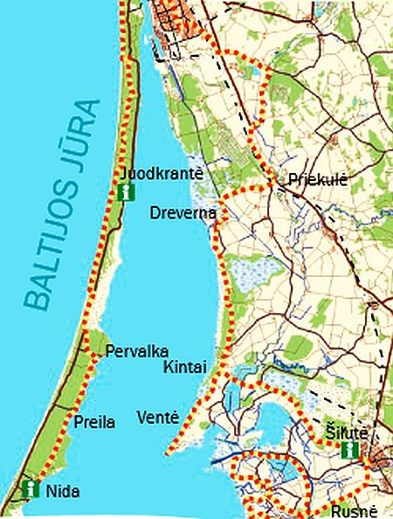
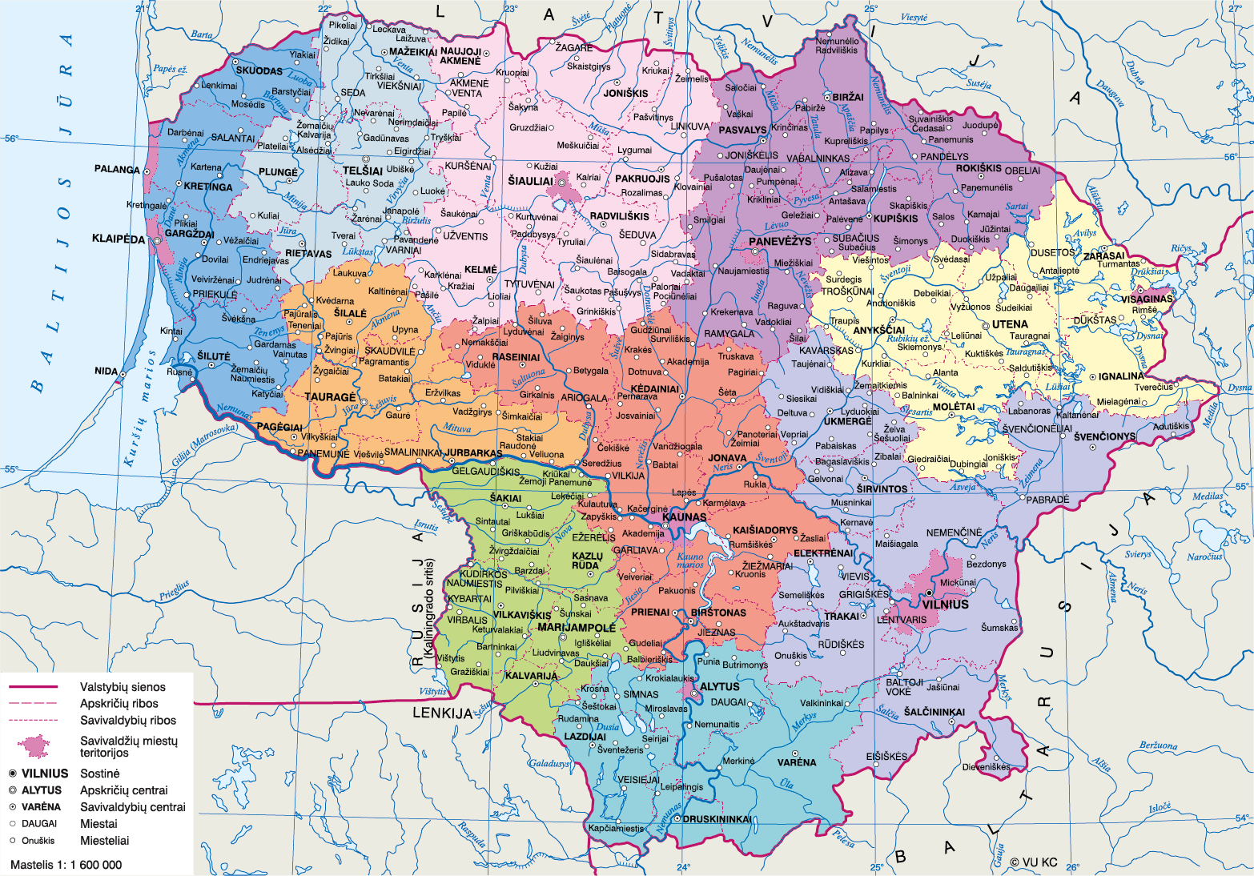
LITHUANIA
VENTE CAPE
LOCATION
Map of Lithuania
Žemėlapiai
Map of Vente
Baltų žinyčios vartai » Ženklas krantui, kurio laiveliai išsilenkdavo

Slide 3
Lithuania VENTE CAPE
TIPE OF SITE
Vente cape is a naturalistic headland of Nemunas delta with architectural buildings and ornithological station.
PHYSICAL AND AESTHETIC FEATURES
There is an 11-metre-high lighthouse built in 1863, where you can see view of the Curonian Lagoon, the Curonian Spit, the Dead dunes and Nida from up high.
AREA COVERED
Vente cape headlands length is 5.5 km and maximum width is 2,2 km.
HISTORICAL/SCIENTIFIC/ARTISTIC INFORMATION
Vente cape is known as a resting place for many birds during their migrations, particularly the autumn migration. Vente Cape Ornithological Station is one of the first bird ringing stations in Europe.
DATING
History of Vente Cape starts back in the 1360. The ornithological station in Vente Cape was established in 1929 by professor Tadas Ivanauskas.

Slide 4
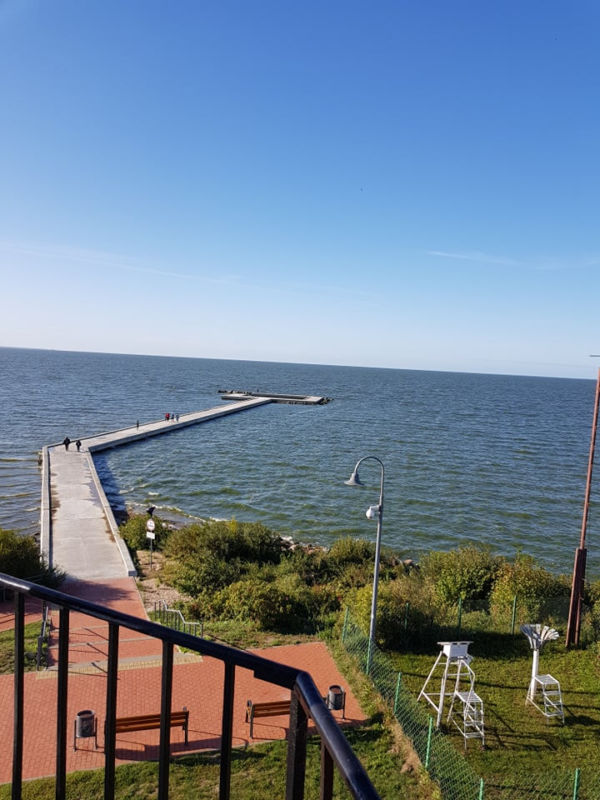
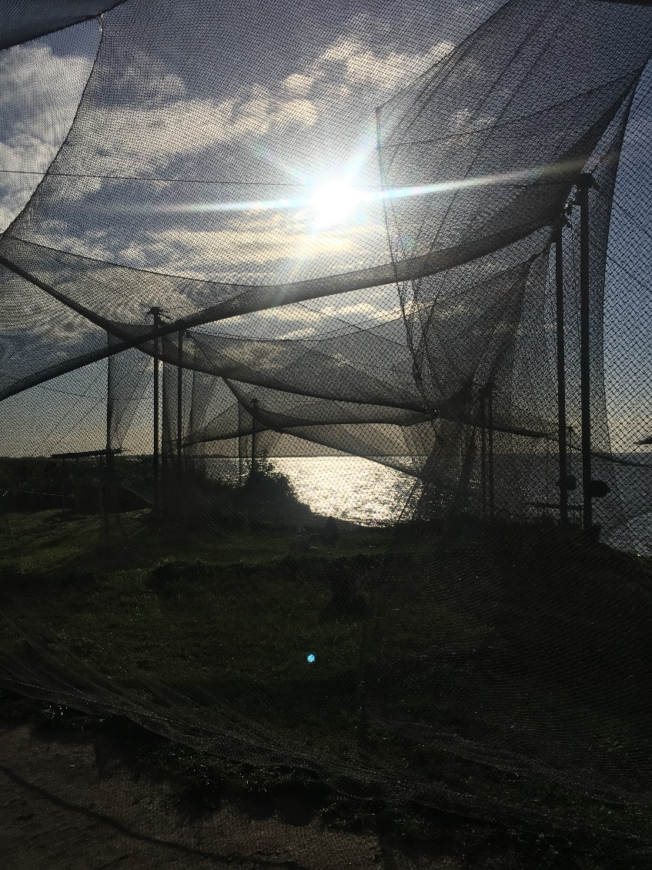
Lithuania
VENTE CAPE
HIGHLIGHTS
View from the lighthouse
Birds catching nets

Slide 5
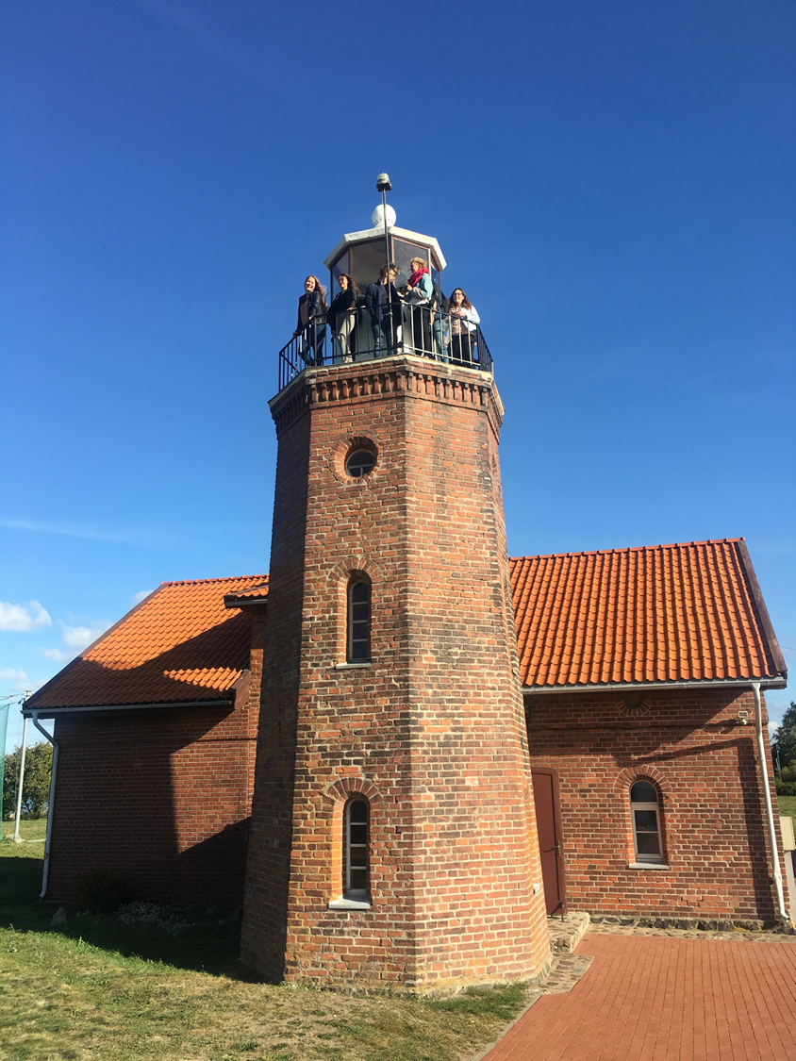
Lithuania VENTE CAPE
CONDITION OF PRESERVATION
In 1975 the spike of Vente Cape was reconstructed, shored up and paved by boulders.
VISITING TIME
Monday- Friday
10:00 -19:00 pm
Saturday- Sunday
10:00 -20:00 pm
LEGAL OWNERSHIP
Vente Cape is a public site, owned by Vente town authorities.
TICKETS AND BOOKING
You can buy tickets directly in the ornithological station or, if you want a tour guide, you need to make a reservation. For adults ticket costs 3 €, for students and elderly it costs 2 € and for pre- school children it′s for free.
Vente Cape lighthouse

Slide 6
Lithuania VENTE CAPE
ACCESSIBILITY
You can reach Vente by bus or you can go there by your own car. Also this year (in 2018) a 1.6 km waterway to Ventė Cape was launched, so there is also a possibility to reach this site by yacht or by a recreational boat. Paths in Vente Cape are safe, so disabled people also can reach this site.
FACILITIES
There are two hotels: ,,Ventaine” and ,,Ventes rest$”$. There is a small supermarket, souvenire shop and toilets in the parking lot of Vente Cape.

